Slide 1
Immersive
Real world
Hands-on
Experiential
Experience
Confidence
Managing
Entrepreneurship
The Game
Responsibility
Process Flow
Sandbox

Slide 2
Emulate being a Manager
Management
Monitoring
Measures
Metrics
Managing (Decisions)
Choices
Benefits analysis
Milestones
Responsibility
Accountability

Slide 3
Your Environment (5 Markets you select up to 3)
Competition
Features
VP
Price
Cost
Marketing
Promotions
Inventory
HR
Your Product
Features
VP
Price
Cost
Marketing
Promotions
Inventory
HR
Market
Population
Attributes (VP)
Desired Price
Competitors
Competition
Features
VP
Price
Cost
Marketing
Promotions
Inventory
HR
Competition
Features
VP
Price
Cost
Marketing
Promotions
Inventory
HR
Competition
Features
VP
Price
Cost
Marketing
Promotions
Inventory
HR

Slide 4
Benefits of a Simulation
An immersive hands-on experience
The opportunity to practice what you have learned
A product design experience and appreciation of the importance of the value proposition
An opportunity to perform market analyses and experience the impact of your decisions
Analyzing a variety of advertising approaches to create an advertising campaign
Gain experience in managing cash flow and understanding sources of funds
Acquire insight into the real-world difficulties of projecting sales and the impact of excess inventory
Experience the dilution of ownership when selling shares in your privately held corporation
A “sandbox” to test your strategies and compete with other students
An opportunity to become better managers by doing and experiencing the thrill of managing
A hands-on opportunity to practice ‘responsibility’ and experience being accountable
A confidence building experiential learning tool that supports your learning

Slide 5
Topics
Understanding the process of starting a business
The importance of the 4P’s/7P’s in product marketing
Determining a products Value Proposition and the usage of ‘EVAC’ (Effort, Value, Acceptance & Cost)
The forces that can cause a business failure
The differences between management, creativity, and innovation
An experiential approach to preparing a business plan
Identifying the market niche of a product or service
Describing the components of a marketing plan and be able to prepare one
Projecting unit sales and revenue
Developing a pricing strategy for a product
Understanding the ‘Knowledge Chain’ culminating in Actionable Knowledge
Creating and managing a Projected Cash Flow spreadsheet
Managing debt and equity capital
Employing the Monitoring of measures & metrics and when necessary, Manage (the actions)

Slide 6
Simulation Content (Items in red not simulated in the simulation)
Product Design
Product Value Proposition
EVAC
Effort to use and make product
Value Proposition of product
Acceptance by market
Cost of product
Inventory Management
Cost vs. Price Analysis (GM)
Cash Flow Management
7P’s
Price
Placement
Promotion
Product
Projections
Packaging
Product Name
Gap Analysis
Ad Effectiveness
Marketing mix
Market Analysis
Market segments
Advertising
Ad Campaigns
Promotional Budgets
Competitor Analysis
HR impact:
Sales
Operations
Common Stock control

Slide 7
Entrepreneurship – The Game
Due Diligence
Marketing
Cash Flow & HR
Product & Markets
Process

Slide 8
You make decisions in the 3 Functional Areas
Functional Pages
Main Screen
Decision Milestones
Due Dates
If your simulation restricts product modifications after Quarter 1 a message will appear here

Slide 9
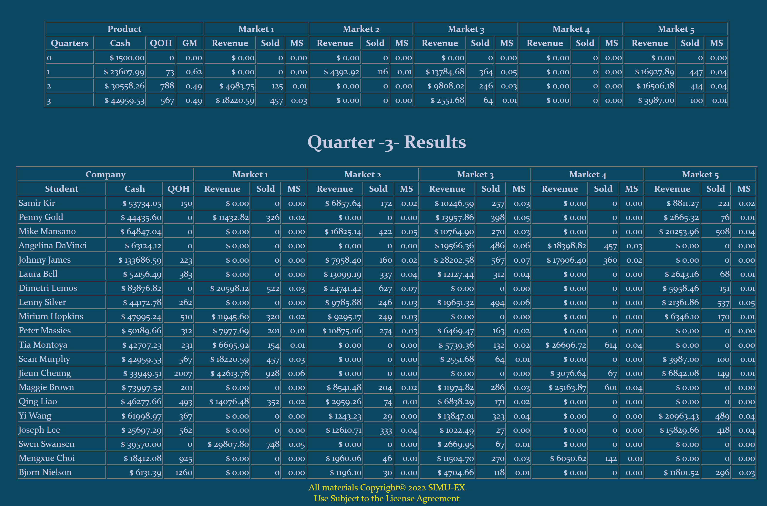
Log Into Your Main Screen
Product
Design
Marketing
Decisions
Cash Flow
Management
Quarter Process
Growth
Quarterly
Cycle
Your Quarterly Results
Will be Important starting in Quarter 2
Results for the current Quarter
Gap

Slide 10
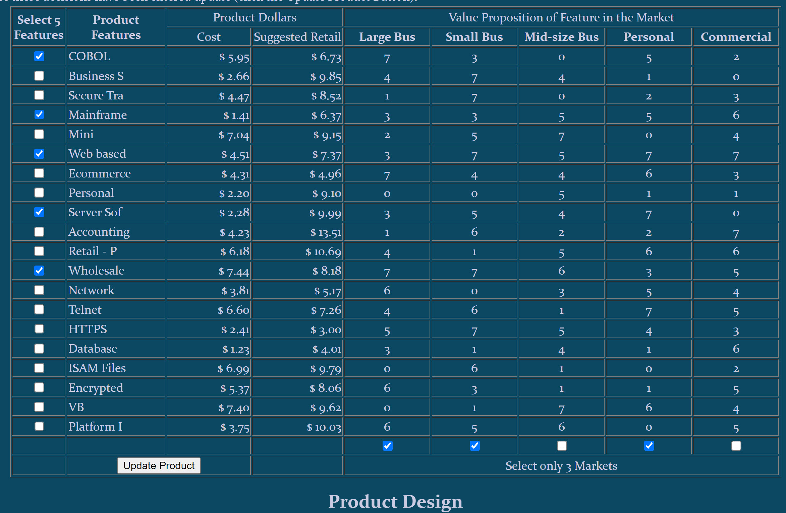
Product Design and Markets
Product
Design
Marketing
Decisions
Cash Flow
Management
Quarter Process
Quarterly
Cycle
VP range 0-7
Max VP 35
3 Markets
Results of the Product Design
Results
Product may have up to 5 Features.
May select up to 3 Markets

Slide 11
Product Design and Markets
Product
Design
Marketing
Decisions
Cash Flow
Management
Quarter Process
Quarterly
Cycle
VP range 0-7
Max VP 35
Results of the Product Design
May select up to 3 Markets
Maximize VP
Product may have up to 5 Features.
Results
Or Adjust
Market Population Current Qtr

Slide 12
Log Into Your Main Screen
Product
Design
Marketing
Decisions
Cash Flow
Management
Quarter Process
Quarterly
Cycle
Your Quarterly Results
Cash in Bank
QOH
GM
Revenue in Markets
Units Sold in Markets
Market Share
Growth?
Quarter 2, 3 and 4
QOH
Revenue in Markets
Units Sold in Markets
Market Share
Cash Analysis
Gap Analysis
Results for the current Quarter
Main Screen
Analysis Qtr 2, Qtr 3 & Qtr 4

Slide 13
Product Redesign and Market Changes
Product
Design
Marketing
Decisions
Cash Flow
Management
Quarter Process
Quarterly
Cycle
If allowed and deemed necessary, revise product
VP range 0-7
Max VP 35
3 Markets
Results of the Product Design
Results
Product may have up to 5 Features.
Revise the Markets

Slide 14
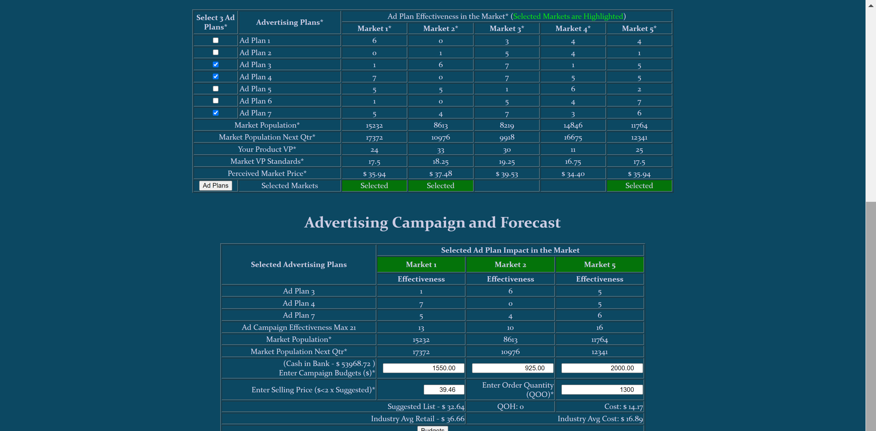
Ad Plans, Promotional Budgets, Price and Projections
Product
Design
Marketing
Decisions
Cash Flow
Management
Quarter Process
Up to 3 Ad Plans
Effectiveness range 0-7
Max Effectiveness 21
For your previously selected 3 Markets
Quarterly
Cycle
Promotional Budgets for each Ad Campaign. Consider effectiveness, Product VP and population
Ad Campaign Effectiveness. If low see if a new ad Campaign with a higher effectiveness can be developed
Quantity of Product (units) to order for sale. Take into consideration any QOH
Determine a Retail Price

Slide 15
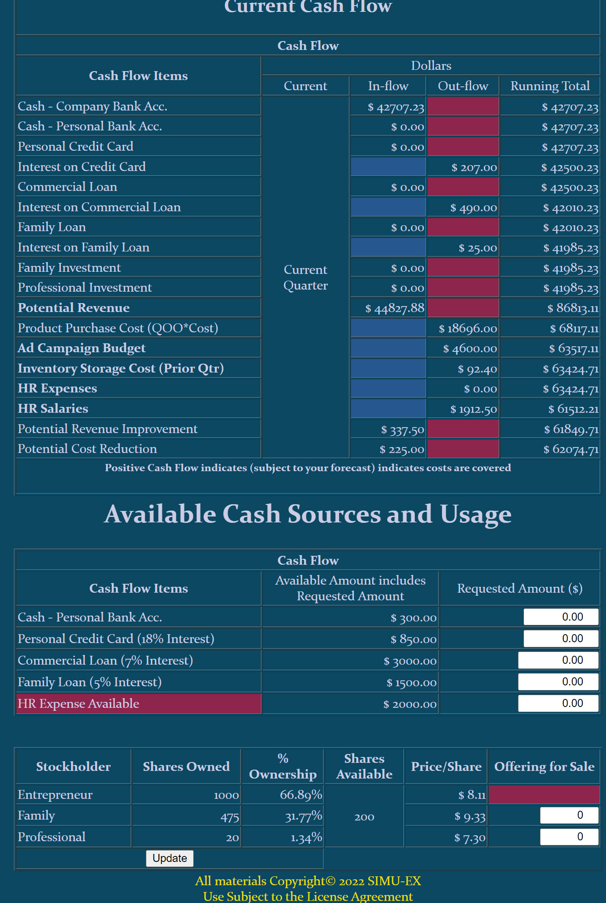
Capital Sources and HR Expenses
Product
Design
Marketing
Decisions
Cash Flow
Management
Quarter Process
Quarterly
Cycle
Sources of Funds and available amounts
Review the Cash Flow
HR Expense
Stock Sales

Slide 16
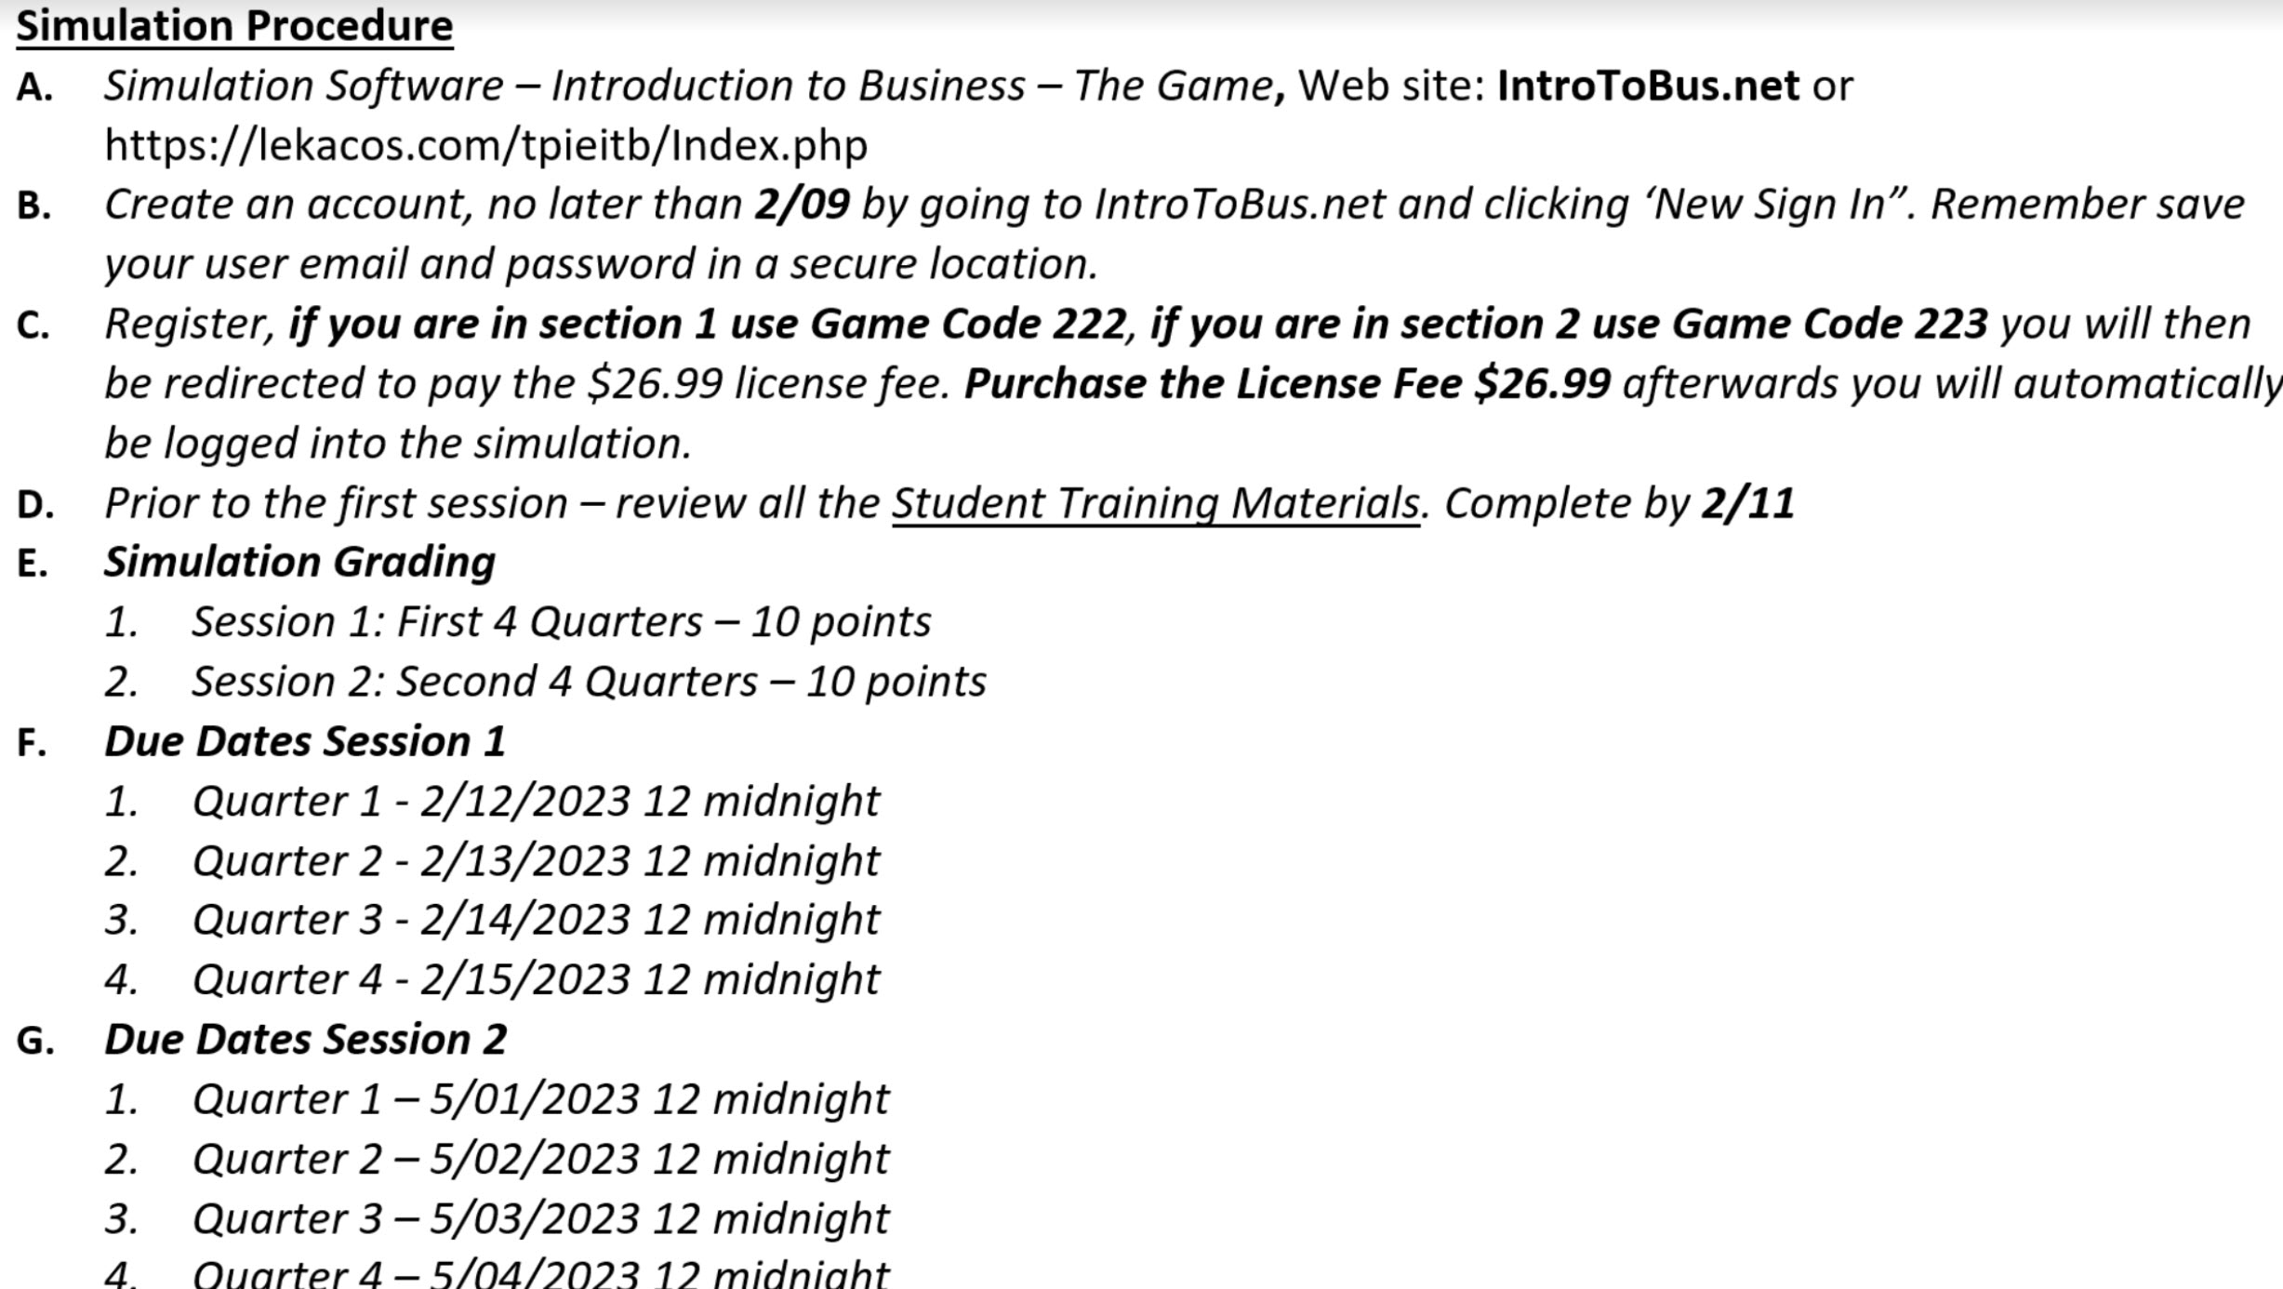
Let’s Review
Four step process for each quarter
Product
Design
Marketing
Decisions
Cash Flow
Management
Quarter Process
Milestones
Quarterly
Cycle

Slide 17
1 - Main Screen
Product
Design
Marketing
Decisions
Cash Flow
Management
Quarter Process
Quarterly
Cycle
Growth Table
Main Screen
Your Quarterly Results
Cash in Bank
QOH
GM
Revenue in Markets
Units Sold in Markets
Market Share
Growth?
Gap Table
Quarter 2, 3 and 4
QOH
Revenue in Markets
Units Sold in Markets
Market Share
Cash Analysis
Gap Analysis

Slide 18
2 - Product Design and Markets
Product
Design
Marketing
Decisions
Cash Flow
Management
Quarter Process
Quarterly
Cycle
VP range 0-7
Max VP 35
3 Markets
❖ 5 Features
❖ 3 Markets

Slide 19
3 - Ad Plans, Promotional Budgets, Price and Projections
Product
Design
Marketing
Decisions
Cash Flow
Management
Quarter Process
Quarterly
Cycle
⬥ 3 Ad Plans
⬥ Promotional Budgets
⬥ Quantity of Product to order
⬥ Retail Price

Slide 20
4 - Capital Sources and HR Expenses
Product
Design
Marketing
Decisions
Cash Flow
Management
Quarter Process
Quarterly
Cycle
 Sources of Funds
 HR Expense
 Stock Sales

Slide 21
Simulation Decision Checklist
Review Growth and Gap tables (Main Page starting in Quarter 2)
Product Page (if allowed after Quarter 1)
Select or review 5 features
Select or review 3 Markets
Marketing Page
Select or review 3 Ad Plans features
Change or review Promotional Budgets for the 3 Markets
Change or review Selling Price
Change or review Quantity to Order (QOO)
Cash Flow Page
Use or review Cash Personal Bank
Use or review Personal Credit Card
Use or review Commercial Loan
Use or review Family Loan
Use or review Family Investment
Use or review Professional Investment
Select or review HR
Product
Design
Marketing
Decisions
Cash Flow
Management
Quarter Process
Quarterly
Cycle

Slide 22
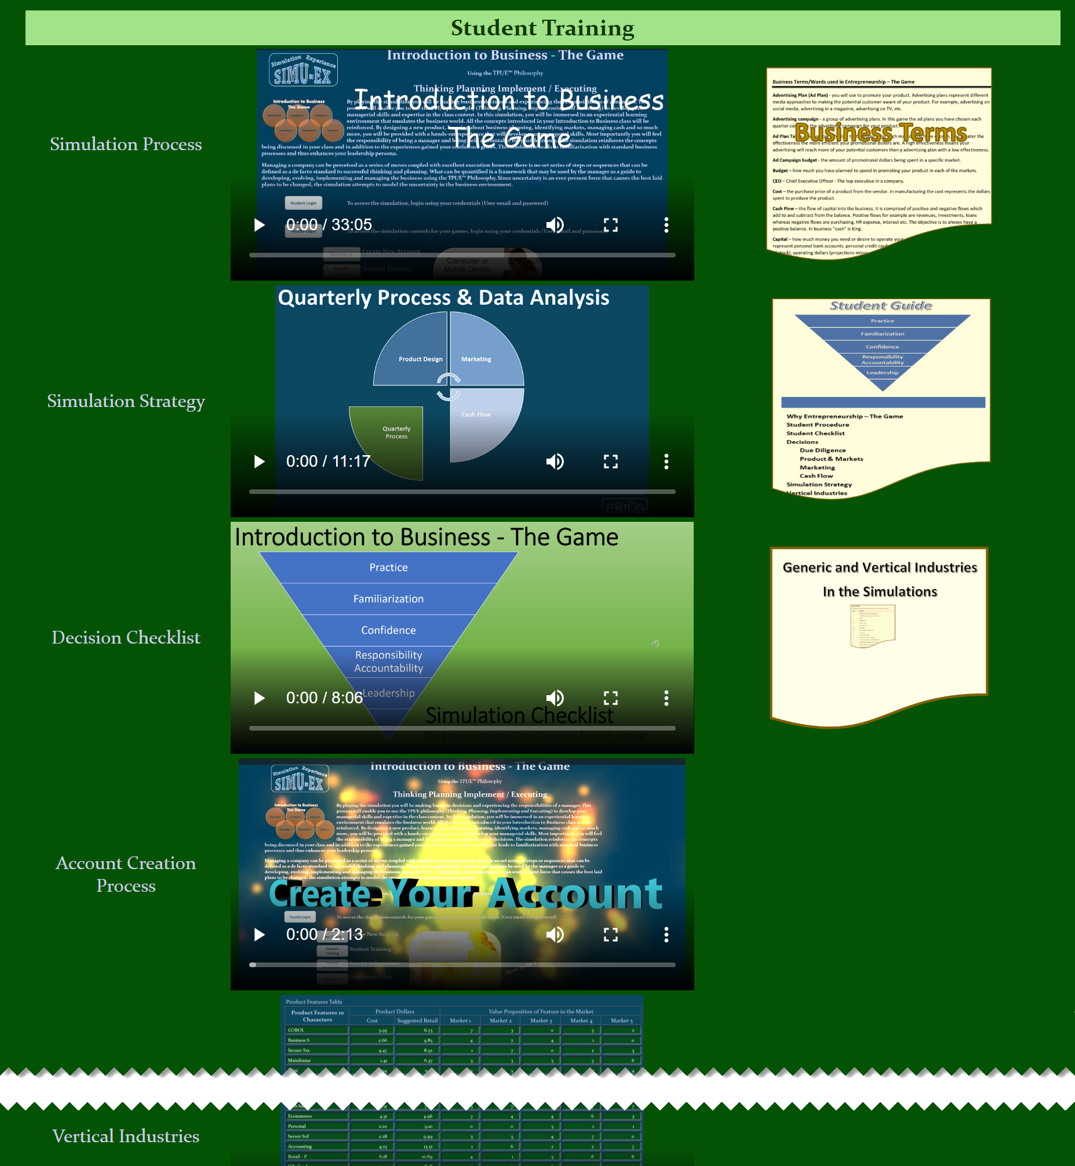
Web Site
Training Materials
Review all!

